Slide 1
Design Pattern

Slide 2
A design pattern is proved solution for solving the specific problem/task.
We need to keep in mind that design patterns are programming language independent for solving the common object-oriented design problems.
In Other Words, a design pattern represents an idea, not a particular implementation.
Using design patterns you can make your code more flexible, reusable, and maintainable.

Slide 3
Types of design patterns: There are 3 types of Design Patterns in java that are depicted more clearly in a tabular format below.
Behavioral Design Pattern
Creational Design Pattern
Structural Design Pattern
Architectural
While developing the software we should use all these design patterns.
But depending upon the requirement it should be decided that to use which design pattern.

Slide 4
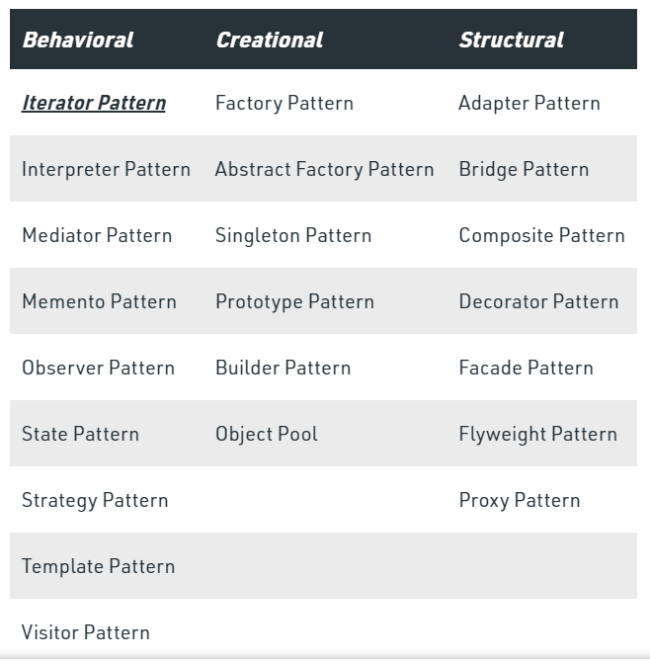

Slide 5
Factory Design Pattern
It belongs to creational design pattern.
Ex-
OS-Phone
Iphone-IOS
Samsung-Android
Nokia-Windows
Some people don’t have idea about OS simply they need a phone.

Slide 6
So you want an OS for your phone that you are building.
Depending upon type of OS you want to go for like
Open source- Android
Closed source- IOS
Other- Windows
You simply specify your requirement accordingly an OS will be created for you.

Slide 7
The Benefit of this is user will specify their requirement and someone else will create object.
Due to this if tomorrow Android is replaced by XYZ then user need not have to worry about this. Who is giving these objects Factory Design Pattern.

Slide 8
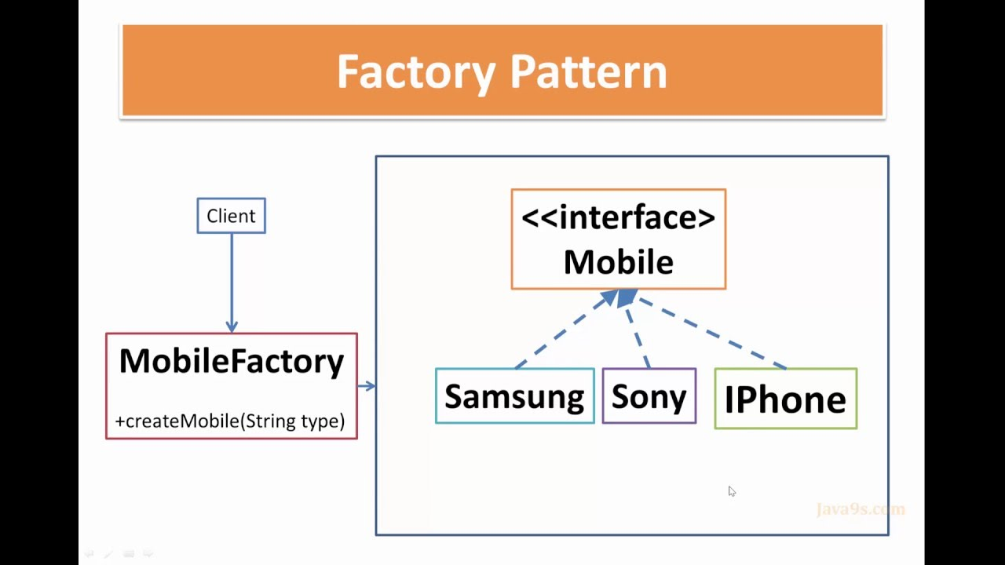

Slide 9
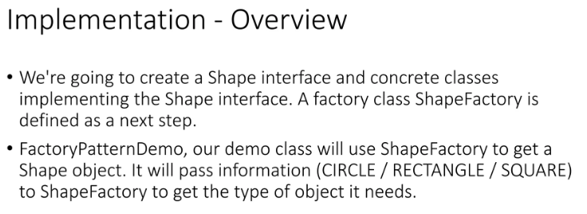

Slide 10
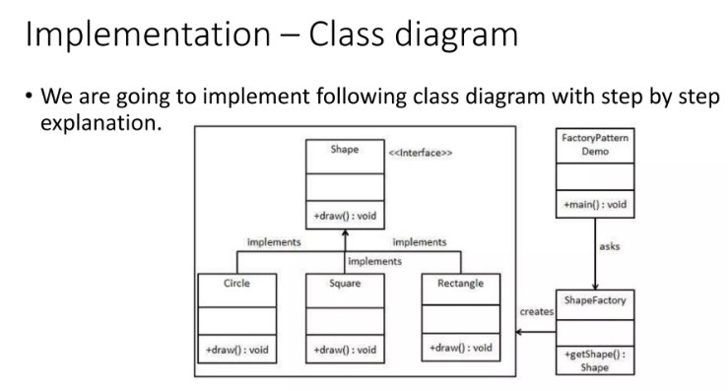

Slide 11
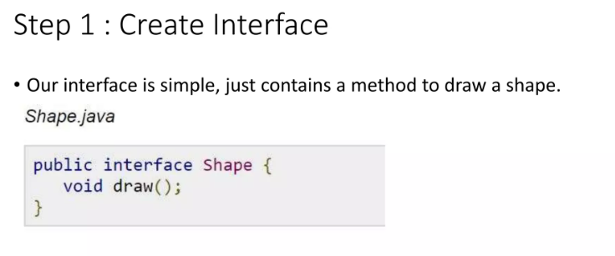

Slide 12
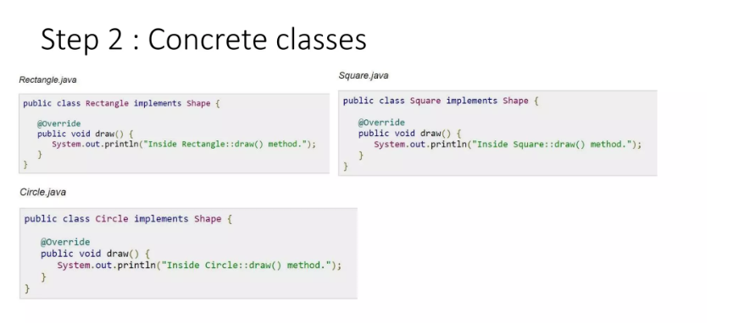

Slide 13
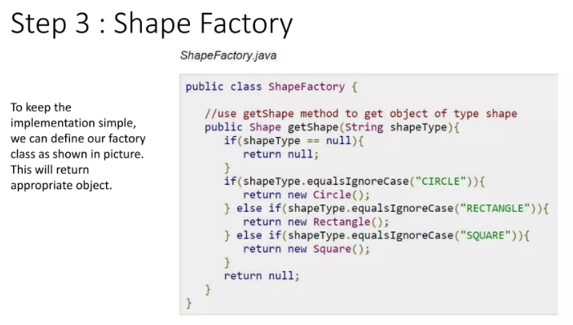

Slide 14
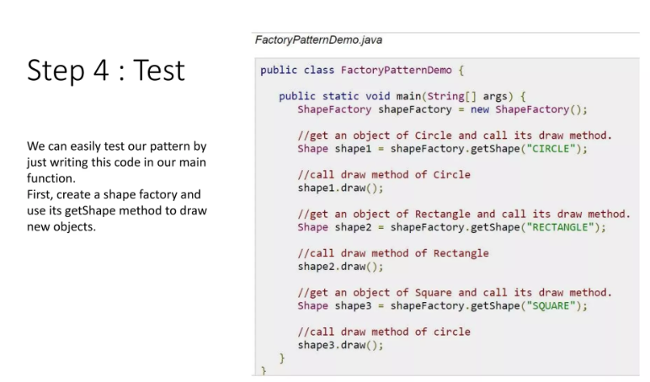

Slide 15
Why Factory Design Pattern is Creational pattern?
(In class-based programming) the factory method pattern is a creational pattern
that uses
factory methods to deal with the problem of creating objects
without
having to specify the exact class of the object that will be created.

Slide 16
Usage
When a class doesn't know what sub-classes will be required to create
When a class wants that its sub-classes specify the objects to be created.
When the parent classes choose the creation of objects to its sub-classes.

Slide 17
Calculate Electricity Bill : A Real World Example of Factory Method
Step 1: Create a Plan abstract class.
import java.io.*; /* io concepts are being used that's why we are importing io pacakage.*/
import java.io.*;
abstract class Plan{ //Why Abstract
protected double rate; // Why protected
abstract void getRate();
public void calculateBill(int units){
System.out.println(units*rate);
}
}//end of Plan class.

Slide 18
Step 2: Create the concrete classes that extends Plan abstract class.
class DomesticPlan extends Plan{ //what is extends?
//@override //what is override
public void getRate(){
rate=3.50;
}
}//end of DomesticPlan class.

Slide 19
Step 2: Create the concrete classes that extends Plan abstract class.
class CommercialPlan extends Plan{
//@override
public void getRate(){
rate=7.50;
}
/end of CommercialPlan class.

Slide 20
Step 2: Create the concrete classes that extends Plan abstract class.
class InstitutionalPlan extends Plan{
//@override
public void getRate(){
rate=5.50;
}
/end of InstitutionalPlan class.

Slide 21
Step 3: Create a GetPlanFactory to generate object of concrete classes based on given information.
class GetPlanFactory{
//use getPlan method to get object of type Plan
public Plan getPlan(String planType){ // what is being happened here?
if(planType == null){
return null;
}
if(planType.equalsIgnoreCase("DOMESTICPLAN")) { // equalsignoreclass?
return new DomesticPlan(); // why new?
}
else if(planType.equalsIgnoreCase("COMMERCIALPLAN")){
return new CommercialPlan();
}
else if(planType.equalsIgnoreCase("INSTITUTIONALPLAN")) {
return new InstitutionalPlan();
}
return null;
}
}//end of GetPlanFactory class.

Slide 22
Step 4: Generate Bill by using the GetPlanFactory to get the object of concrete classes by passing an information such as type of plan DOMESTICPLAN or COMMERCIALPLAN or INSTITUTIONALPLAN.
import java.io.*;
class GenerateBill{
public static void main(String args[])throws IOException{ //Significance of this coding?
GetPlanFactory planFactory = new GetPlanFactory(); //what is being happened here?
System.out.print("Enter the name of plan for which the bill will be generated: ");
BufferedReader br=new BufferedReader(new InputStreamReader(System.in)); //what is being happened here?
String planName=br.readLine(); //what is being happened here?
System.out.print("Enter the number of units for bill will be calculated: ");
int units=Integer.parseInt(br.readLine()); //what is being happened here?
Plan p = planFactory.getPlan(planName); //what is being happened here?
//call getRate() method and calculateBill()method of DomesticPaln.
System.out.print("Bill amount for "+planName+" of "+units+" units is: ");
p.getRate();
p.calculateBill(units);
}
}//end of GenerateBill class.

